Slide 1
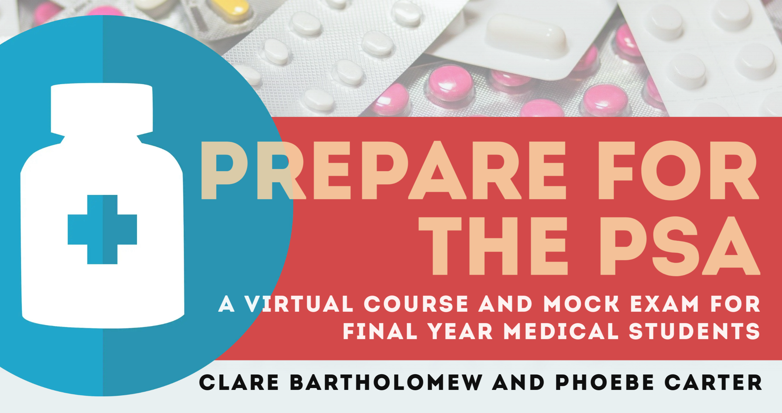

Slide 2
Prepare for the PSA Mock Exam - ANSWERS

Slide 3


Prescribing
Once Only Medicines
10 marks
Case presentation
A 12-year-old boy is brought to his GP for travel vaccinations. He begins to have a tonic-clonic seizure which is still ongoing after 5 minutes. PMH. Epilepsy. DH. Sodium valproate 500mg PO twice daily.
PRESCRIPTION FORM
Medicine
Dose
Route
Frequency Duration
Once only Once only
Prescriber Date Time
Joe Bloggs 01/01/2021 12:00
Prescribing request
Write a prescription for ONE drug that is most appropriate to treat his condition.
(use the ‘general practice’ prescription form provided)
PWS Q1

Slide 4


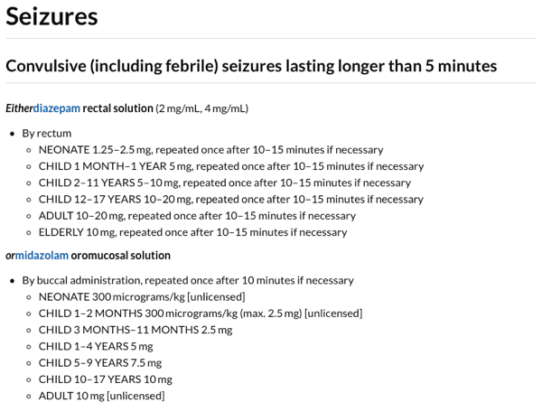
Status epilepticus
diazepam 10mg PR
midazolam 10mg buccal
Note that there are two treatment summaries above. If this question was about a child in hospital the management would be midazolam buccal or lorazepam IV.
PWS A1

Slide 5
Prescribing
General Practice
10 marks
Case presentation
A 70-year-old woman presents to her GP with ongoing problems with urge incontinence. She has tried 6 weeks of bladder retraining with no improvement. PMH. HTN. DH. Amlodipine 5mg PO once daily.
PRESCRIPTION FORM
Medicine
Dose Route
Frequency Duration
7 days
Prescriber Date
Joe Bloggs 01/01/2021
Prescribing request
Write a prescription for ONE drug that is most appropriate to treat her condition.
(use the ‘general practice’ prescription form provided)
PWS Q2

Slide 6

Incontinence
oxybutynin hydrochloride (IR) 2.5-5mg PO twice daily
tolterodine tartrate (IR) 2mg PO twice daily
darifenacin 7.5mg PO once daily
Stress incontinence – #1 pelvic floor muscle training for 3mo, #2 surgery
Urge incontinence / overactive bladder – #1 bladder retraining for 6w, #2 anticholinergic (mirabegron if contraindicated, ineffective, or not tolerated as B3 agonist so different MOA and less anticholinergic effects)
Note in this scenario the patient is 70 years old with only HTN as her PMHx – on the ‘Urinary incontinence’ Treatment summary it states to avoid oxybutynin if the patient is frail/elderly and at sudden risk from deterioration in their physical or mental heath – the patient in this scenario does not really meet this description. Hence why we suggested the first line options as the answer. However, in exam question marks likely to be awarded for mirabegron too although they are likely to make question stem more clear cut.
PWS Q2

Slide 7
Prescribing
Once Only Medicines
10 marks
Case presentation
A 44-year-old man presents to A&E in a collapsed state. His partner reports he has taken an overdose of morphine around 2 hours ago. PMH. Depression. DH. Citalopram 20mg PO once daily.
On examination
Airway patent, drowsy but rousable, confused. Sats 98% on RA, RR 8, chest clear. BP 122/68, HR 60 and regular, HS I+II+0, cap refill 2s. T 36.9, pinpoint pupils, GCS 13/15, capillary glucose 5.0. Abdomen SNT, no peripheral oedema.
PRESCRIPTION FORM
Medicine
Dose
Route
Frequency Duration
Once only Once only
Prescriber Date Time
Joe Bloggs 01/01/2021 12:00
Prescribing request
Write a prescription for ONE drug that is most appropriate to treat his condition.
(use the ‘once only’ prescription form provided)
PWS Q3

Slide 8

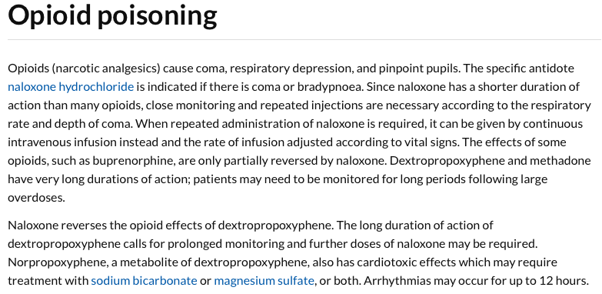
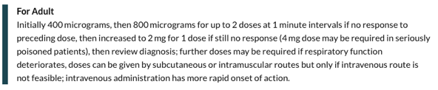
Opioid overdose
naloxone hydrochloride 400mcg IV
The treatment summary ‘Poisoning, emergency treatment’ is excellent and covers a lot
Remember if ingestion <1h ago activated charcoal can be used (but not for some drugs e.g. lithium)
PWS Q3

Slide 9
Prescribing
Hospital Fluid
10 marks
Case presentation
A 60-year-old man is admitted to hospital for an elective right hemicolectomy. He is waiting for the procedure on the surgical ward, however, the operation is delayed. Weight 80kg. PMH. COPD, T2DM. DH. Salbutamol MDI 2 puffs PRN, fluticasone proprionate 250mcg/salmeterol 50mcg (Seretide 250 Accuhaler) 1 puff twice daily, metformin 500mg TDS.
Investigations
Na 140 (137-144), K 4.0 (3.5-5.3), U 4.1 (2.5-7.0), Cr 90 (60-110), capillary glucose 11.6
He has had one bag of sodium chloride 0.9% / glucose 5% 1000ml over the last 12h.
PRESCRIPTION FORM
Infusion fluid
Volume Route
IV
Duration Infusion rate (ml/min)
Prescriber Date Time
Joe Bloggs 01/01/2021 12:00
Prescribing request
Write a prescription for ONE IV fluid that is most appropriate for the patient at this stage?
(use the ‘hospital IV fluid’ prescription form provided)
PWS Q4

Slide 10
Maintenance only but previous bag given
sodium chloride 0.9% / potassium chloride 0.3%, 1000ml over 8-12h
potassium chloride 0.3% / glucose 5% less appropriate (but might score some marks) given PMH of T2DM and high BM although likely to score more/full marks if this was not the case
Daily requirements | Specific to weight of 60kg | 1st bag Sodium chloride 0.9% / glucose 5% 1000ml 12h | Requirements for next bag | 2nd bag Sodium chloride 0.9% / potassium chloride 0.3% 1000ml 8-12h
25-30ml/kg/day water | 30 x 80 = 2400ml water | 1000ml water | Needs 1400ml water | 1000ml water
1mmol/kg/day Na | 1 x 80 = 80mmol Na | 150mmol Na | - | 150mmol Na
1mmol/kg/day K | 1 x 80 = 80mmol K | - | Needs 80mmol K | 40mmol K
50-100g/day glucose | 50-100g glucose | 50g | - | -
PWS Q4

Slide 11
Prescription review
4 marks
Case presentation
A 72-year-old woman is on a medical ward following an acute exacerbation of COPD with additional acute pyelonephritis. Weight 49kg. PMH. Hypercholesterolaemia, hypertension, hypothyroidism, osteoporosis, polymyalgia rheumatica. DH. Her current regular medications are listed (right).
CURRENT PRESCRIPTIONS
Medicine | Dose | Route | Frequency | A | B
amlodipine | 10 mg | PO | daily
alendronic acid | 70 mg | PO | weekly
atorvastatin | 40 mg | PO | nightly
colecalciferol | 400 units | PO | daily
gentamicin | 400 mg | IV | daily
levothyroxine sodium | 125 mcg | PO | daily
paracetamol | 1000 mg | IV | four times daily (6-hrly)
prednisolone | 60 mg | PO | nightly
Question A
Select THREE prescriptions that contain a serious dosing error.
(mark them with a tick in column A)
Question B
Select ONE prescription that contains a frequency error.
(mark them with a tick in column B)
REV Q1

Slide 12
Prescription review
4 marks
Case presentation
A 72-year-old woman is on a medical ward following an acute exacerbation of COPD with additional acute pyelonephritis. Weight 49kg. PMH. Hypercholesterolaemia, hypertension, hypothyroidism, osteoporosis, polymyalgia rheumatica. DH. Her current regular medications are listed (right).
CURRENT PRESCRIPTIONS
Medicine | Dose | Route | Frequency | A | B
amlodipine | 10 mg | PO | daily
alendronic acid | 70 mg | PO | weekly
atorvastatin | 40 mg | PO | nightly
colecalciferol | 400 units | PO | daily
gentamicin | 400 mg | IV | daily | ✓
levothyroxine sodium | 125 mcg | PO | daily
paracetamol | 1000 mg | IV | four times daily (6-hrly) | ✓
prednisolone | 60 mg | PO | nightly | ✓ | ✓
Question A
Select THREE prescriptions that contain a serious dosing error.
(mark them with a tick in column A)
Question B
Select ONE prescription that contains a frequency error.
(mark them with a tick in column B)
Gentamicin dose is too high here, should be 5-7mg/kg as per BNF
Paracetamol dose is too high here, should be 15mg/kg as per BNF (but in hospital we just do 500mg doses for patients <50kg)
Prednisolone dose is too high here, prednisolone 30mg PO daily for eCOPD as per session 2 teaching
Prednisolone is given in the morning not nightly otherwise the patient won’t be able to sleep!
REV A1

Slide 13
Prescription review
4 marks
Case presentation
A 84-year-old woman is on a medical ward following a fall causing a shoulder fracture. Weight 76kg. PMH. Hypertension, neuropathic pain, rheumatoid arthritis, T2DM. DH. Her current regular medications are listed (right).
Investigations
Capillary glucose 6.1. XR shoulder – fractured humeral head
CURRENT PRESCRIPTIONS
Medicine | Dose | Route | Frequency | A | B
amitriptyline | 75 mg | PO | nightly
metformin | 1000 mg | PO | twice daily
omeprazole | 20 mg | PO | daily
prednisolone | 10 mg | PO | daily
ramipril | 2.5 mg | PO | daily
gliclazide | 40 mg | PO | daily
Question A
Select TWO medications that are most likely to have increased her risk of falls.
(mark them with a tick in column A)
Question B
Select TWO medications that are most likely to have increased her risk of a fracture.
(mark them with a tick in column B)
REV Q2

Slide 14
Prescription review
4 marks
Case presentation
An 84-year-old woman is on a medical ward when she falls in her bay sustaining a shoulder fracture. Weight 76kg. PMH. Hypertension, neuropathic pain, rheumatoid arthritis, T2DM. DH. Her current regular medications are listed (right).
Investigations
Capillary glucose 6.1. XR shoulder – L proximal humerus #
CURRENT PRESCRIPTIONS
Medicine | Dose | Route | Frequency | A | B
amitriptyline | 75 mg | PO | nightly | ✓
metformin | 1000 mg | PO | twice daily
omeprazole | 20 mg | PO | daily |  | ✓
prednisolone | 10 mg | PO | daily |  | ✓
ramipril | 2.5 mg | PO | daily | ✓
gliclazide | 40 mg | PO | daily
Question A
Select TWO medications that are most likely to have increased her risk of falls.
(mark them with a tick in column A)
Amitriptyline, particularly at higher doses, can increase risk of anticholinergic syndrome, drowsiness, postural hypotension contributing to falls
Ramipril commonly causes dizziness, drowsiness and hypotension
All PPIs increase fracture risk; this is a classic PSA question!
All steroids increase fracture risk; only PO steroids though and not inhalers
(Sulfonylureas do cause hypoglycemia but note the normal BM)
Question B
Select TWO medications that are most likely to have increased her risk of a fracture.
(mark them with a tick in column B)
REV A2

Slide 15
True scenario seen I saw on the ward when working as an F1. Here is the XR shoulder. The patient wasn’t supervised in the bay and got up and fell. Happened when I was at lunch and when I returned, I spoke to her and examined her shoulder. No bruising or deformity, no obvious abnormalities on palpation, patient still able to move arm but in pain. I went ahead and ordered an XR to be safe and she had an obvious proximal humerus fracture.

Slide 16
Drugs which increase risk of falls | Drugs which increase risk of fractures
Benzodiazepines Antidepressants (particularly TCAs and SNRIs) Monoamine oxidase inhibitors Most antipsychotics Opiates Most antihypertensives (particularly diuretics and alpha-blockers) | PPIs Steroids GnRH agonists (buserelin, goserelin etc)

Slide 17
Prescription review
4 marks
Case presentation
A 54-year-old woman is on a surgical ward with pancreatitis. She has developed sepsis and an associated AKI. Weight 77kg. PMH. T2DM. DH. Her current regular medications are listed (right).
Investigations
Cr 273 (60-110), eGFR 9 (>60). Blood cultures – gram negative rods, cefuroxime (s).
CURRENT PRESCRIPTIONS
Medicine | Dose | Route | Frequency | A | B
cefuroxime | 750 mg | IV | daily
candesartan | 32mg | PO | daily
exenatide | 10 mcg | SC | twice daily
metformin | 1000 mg | PO | twice daily
oxycodone | 10 mg | PO | twice daily
nystatin | 100 000 units | PO | four times daily
paracetamol | 1000 mg | PO | four times daily
sitagliptin | 100 mg | PO | daily
Question A
Select TWO medications that are most likely to have increased his risk of pancreatitis.
(mark them with a tick in column A)
Question B
Select TWO medications that should consider being stopped given her AKI.
(mark them with a tick in column B)
REV Q3

Slide 18
Prescription review
4 marks
Case presentation
A 54-year-old woman is on a surgical ward with pancreatitis. She has developed sepsis and an associated AKI. Weight 77kg. PMH. T2DM. DH. Her current regular medications are listed (right).
Investigations
Cr 273 (60-110), eGFR 9 (>60). Blood cultures – gram negative rods, cefuroxime (s).
CURRENT PRESCRIPTIONS
Medicine | Dose | Route | Frequency | A | B
cefuroxime | 750 mg | IV | daily
candesartan | 32mg | PO | daily |  | ✓
exenatide | 10 mcg | SC | twice daily | ✓
metformin | 1000 mg | PO | twice daily |  | ✓
oxycodone | 10 mg | PO | twice daily
nystatin | 100 000 units | PO | four times daily
paracetamol | 1000 mg | PO | four times daily
sitagliptin | 100 mg | PO | daily | ✓
Question A
Select TWO medications that are most likely to have increased his risk of pancreatitis.
(mark them with a tick in column A)
Question B
Select TWO medications that should consider being stopped given her AKI.
(mark them with a tick in column B)
Exenatide and sitagliptin are examples from T2DM drug classes that both have a risk of pancreatitis, learn the table, will be tested in PSA and finals!
Remember – ‘stop the DAMN drugs’ both ARBs and metformin in this mnemonic
(Cefuroxime is also nephrotoxic and antibiotics often need to be stopped in AKI but the dose is appropriate here for her eGFR)
REV A3

Slide 19
 | Mode of action | Side effects | Weight
Biguanide Metformin | Improves insulin sensitivity in liver/muscle, suppresses hepatic gluconeogenesis | Nausea, diarrhoea, MALA (take care if eGFR <45, stop if eGFR <30) | Neutral
DDP4i Linagliptin | Incretin effect | Pancreatitis, nasopharyngitis | Neutral
Thiazolidinedione Pioglitazone | Improves insulin sensitivity in liver/muscle/fat, suppresses hepatic gluconeogenesis | Oedema, heart failure, post-menopausal osteoporosis, bladder cancer | ↑
Sulfonylurea Gliclazide | Enhances insulin secretion | Hypoglycaemia, cholestasis | ↑
SGLT-2i Empagliflozin | Reduces renal glucose reabsorption | Euglycaemic ketoacidosis, genital infections | Neutral
GLP-1 analogue Exenatide, semaglutide | Incretin effect | Nausea, diarrhoea, pancreatitis | ↓
a-glucosidase inhibitor Acarbose | Reduces intestinal glucose absorption | Bloating, flatulence, diarrhoea | Neutral

Slide 20
Causes of pancreatitis
Idiopathic Gallstones Ethanol Trauma Steroids Mumps/Malignancy Autoimmune Scorpion bite Hypercalaemia, hypertriglyceridaemia ERCP Drugs (many…DDP4i, GLP-1 analogue, mesalazine > sulphasalazine)

Slide 21
The clerking proformas at St Richard’s Hospital contain the following which I think is quite helpful.
Dehydration, urinary obstruction, nephrotoxic drugs, poor urine output and sepsis are all key features of AKI. All patients must be screened and action taken urgently.
D- Dehydration: consider prescribing 500ml normal saline, especially if BP <100 systolic
O- Obstruction: perform a bladder scan if at risk of urinary retention
N- Nephrotoxic drugs: avoid if possible on drug chart
U- Urine output monitoring: ensure input/output monitoring
T- Think sepsis (‘3 in, 3 out’ or ‘bufalo’ – Blood cultures, Urine output, Fluids, Antibiotics, Lactate, Oxygen)
Drugs to stop in AKI
‘Stop the DAMN drugs’ Diuretics ACEi/ARB Metformin NSAIDs But also… Many antibiotics Chemotherapy drugs Iodine based contrast Other drugs can accumulate and cause harm… Opioids

Slide 22
Prescription review
4 marks
Case presentation
A 35-year-old woman presents to her GP with thirst and increased urinary frequency. She is 17 weeks pregnant.
Weight 89kg. PMH. Hypertension, polymyalgia rheumatica, recurrent DVTs. DH. Her current regular medications are listed (right).
Investigations
Capillary glucose 16.8.
CURRENT PRESCRIPTIONS
Medicine | Dose | Route | Frequency | A | B
amlodipine | 10 mg | PO | daily
apixaban | 2.5 mg | PO | twice daily
bendroflumethiazide | 2.5 mg | PO | daily
clotrimazole | 1% cream | top | twice daily
Gaviscon | 10 ml | PO | with meals
lactulose | 15 ml | PO | twice daily
paracetamol | 1000 mg | PO | four times daily
prednisolone | 15 mg | PO | daily
Question A
Select TWO medications that should not be prescribed during pregnancy and stopped immediately.
(mark them with a tick in column A)
Question B
Select TWO medications which might contribute to her deranged glucose level.
(mark them with a tick in column B)
REV Q4

Slide 23
Prescription review
4 marks
Case presentation
A 35-year-old woman presents to her GP with thirst and increased urinary frequency. She is 17 weeks pregnant.
Weight 89kg. PMH. Hypertension, polymyalgia rheumatica, recurrent DVTs. DH. Her current regular medications are listed (right).
Investigations
Capillary glucose 16.8.
CURRENT PRESCRIPTIONS
Medicine | Dose | Route | Frequency | A | B
amlodipine | 10 mg | PO | daily
apixaban | 2.5 mg | PO | twice daily | ✓
bendroflumethiazide | 2.5 mg | PO | daily | ✓ | ✓
clotrimazole | 1% cream | top | twice daily
Gaviscon | 10 ml | PO | with meals
lactulose | 15 ml | PO | twice daily
paracetamol | 1000 mg | PO | four times daily
prednisolone | 15 mg | PO | daily |  | ✓
Question A
Select TWO medications that should not be prescribed during pregnancy and stopped immediately.
(mark them with a tick in column A)
Question B
Select TWO medications which might contribute to her deranged glucose level.
(mark them with a tick in column B)
Apixaban and bendroflumethiazide are both unsafe in pregnancy, this can be found on the ‘Pregnancy’ section of the BNF pages for both drugs (amlodipine and prednisolone both could be considered the answer here but can be prescribed on a risk vs benefit basis)
Thiazide diuretics can commonly cause hyperglycaemia
Steroids commonly cause deranged BMs
REV A4

Slide 24
Planning Management
2 marks
Case presentation
A 65-year-old is brought to A&E by paramedics shaking, confused and aggressive.
Investigations
Capillary glucose 2.1.
MANAGEMENT OPTIONS
glucose 10%, 50mls over 15m IV | 10mg | PO | daily
glucose 10%, 100mls over 15m IV | 70mg | PO | daily
glucose 20%, 50mls over 15m IV | 70mg | PO | daily
glucose 20%, 100mls over 15m IV | 40mg | PO | daily
glucose 50%, 10mls over 15m IV | 2 tablets | PO | twice daily
Question
Select the most appropriate management option at this stage.
MAN Q1

Slide 25
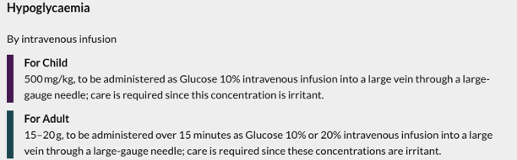
Planning Management
2 marks
Case presentation
A 65-year-old is brought to A&E by paramedics shaking, confused and aggressive.
Investigations
Capillary glucose 2.1.
MANAGEMENT OPTIONS
glucose 10%, 50mls over 15m IV | 10mg | PO | daily
glucose 10%, 100mls over 15m IV | 70mg | PO | daily
glucose 20%, 50mls over 15m IV | 70mg | PO | daily
glucose 20%, 100mls over 15m IV | 40mg | PO | daily |  | ✓
glucose 50%, 10mls over 15m IV | 2 tablets | PO | twice daily
Question
Select the most appropriate management option at this stage.
As per the BNF the treatment for hypoglycaemia is glucose 15-20g administered over 15 minutes as glucose 10% or 20% IV
There is only one correct option that is equivalent to this
Glucose 50% is hypertonic and risks extravasation so would not be appropriate (although it does equate to 20g so the dose would be correct)
MAN A1

Slide 26
Planning Management
2 marks
Case presentation
An 81-year-old man presents to his GP with ongoing falls at home. PMH. T2DM. DH. Metformin 1000mg PO daily.
Investigations
Lying blood pressure 145/95, standing blood pressure 123/84.
MANAGEMENT OPTIONS
offer a fall detector pendant | 10mg | PO | daily
trial of fludrocortisone 100 mcg PO daily | 70mg | PO | daily
arrange occupational therapists to visit and assess fall hazards at home | 40mg | PO | daily
amlodipine 5 mg PO daily | 5mg | PO | daily
offer ambulatory blood pressure monitoring | 2 tablets | PO | twice daily
Question
Select the most appropriate management option at this stage.
MAN Q2

Slide 27
Planning Management
2 marks
Case presentation
An 81-year-old man presents to his GP with ongoing falls at home. PMH. T2DM. DH. Metformin 1000mg PO daily.
Investigations
Lying blood pressure 145/95, standing blood pressure 123/84.
MANAGEMENT OPTIONS
offer a fall detector pendant | 10mg | PO | daily
trial of fludrocortisone 100 mcg PO daily | 70mg | PO | daily |  | ✓
arrange occupational therapists to visit and assess fall hazards at home | 40mg | PO | daily
amlodipine 5 mg PO daily | 5mg | PO | daily
offer ambulatory blood pressure monitoring | 2 tablets | PO | twice daily
Question
Select the most appropriate management option at this stage.
This patient has postural hypotension (also known as orthostatic hypotension). It is diagnosed if a systolic drop of ≥20mmHg and/or a diastolic drop ≥10mmgHg. The first line treatment is fludrocortisone.
It would not be appropriate to offer ABM or amlodipine for a patient of this age with a lying BP of 145/95.
A fall detector pendant or OT assessment would not address the underlying issue of postural hypotension which is the most likely reason for his falls.
MAN A2

Slide 28
Planning Management
2 marks
Case presentation
A 67-year-old woman presents to A&E with worsening SOB and a dry cough. PMH. COPD. DH. Salbutamol 100mcg 2 puffs PRN, tiotropium 18mcg 1 puff once daily.
On examination
Acutely short of breath. Sats 85% on RA, RR 32, reduced air entry. BP 150/98, HR 98 and regular, HS I+II+0, cap refill 2s. Temp 37.3, PEARL, GCS 15/15, capillary glucose 4.8. Abdomen SNT, no peripheral oedema.
Investigations
ABG – pH 7.31, pO2 5.6kPa, pCO2 9.5kPa, HCO3 32.1mmol, BE 2.5mmol
CXR – hyperinflation
MANAGEMENT OPTIONS
4L/min nasal cannulae | 10mg | PO | daily
28% venturi | 70mg | PO | daily
40% venturi | 40mg | PO | daily
15L non-rebreathe mask | 5mg | PO | daily
BiPAP titrating to maintain sats of 88-92% | 2 tablets | PO | twice daily
Question
Select the most appropriate oxygen therapy at this stage.
MAN Q3

Slide 29
Planning Management
2 marks
Case presentation
A 67-year-old woman presents to A&E with worsening SOB and a dry cough. PMH. COPD. DH. Salbutamol 100mcg 2 puffs PRN, tiotropium 18mcg 1 puff once daily.
On examination
Acutely short of breath. Sats 85% on RA, RR 32, reduced air entry. BP 150/98, HR 98 and regular, HS I+II+0, cap refill 2s. Temp 37.3, PEARL, GCS 15/15, capillary glucose 4.8. Abdomen SNT, no peripheral oedema.
Investigations
ABG – pH 7.31, pO2 5.6kPa, pCO2 9.5kPa, HCO3 32.1mmol, BE 2.5mmol
CXR – hyperinflation
MANAGEMENT OPTIONS
4L/min nasal cannulae | 10mg | PO | daily
28% venturi | 70mg | PO | daily |  | ✓
40% venturi | 40mg | PO | daily
15L non-rebreathe mask | 5mg | PO | daily
BiPAP titrating to maintain sats of 88-92% | 2 tablets | PO | twice daily
This patient is having an acute exacerbation of COPD.
From the ABG you can see she is retaining CO2 which means we need to be very cautious about giving lots of O2!
The most appropriate option here is 28% venturi. This is important as we are using a low and controlled concentration of O2.
4L/min nasal cannulae is equivalent to 36% and it is not a controlled amount. 40% venturi and 15L non-rebreathe would be too much O2.
BiPAP would not be a feasible option to start in A&E.
Question
Select the most appropriate oxygen therapy at this stage.
MAN A3

Slide 30
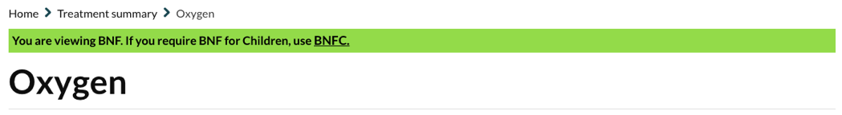
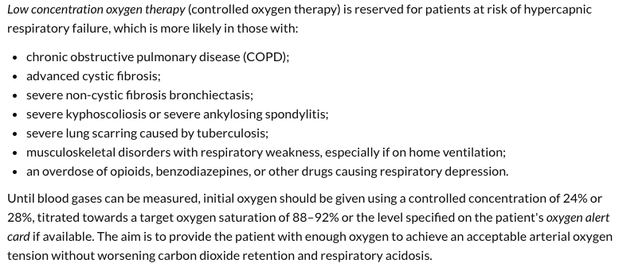

Slide 31
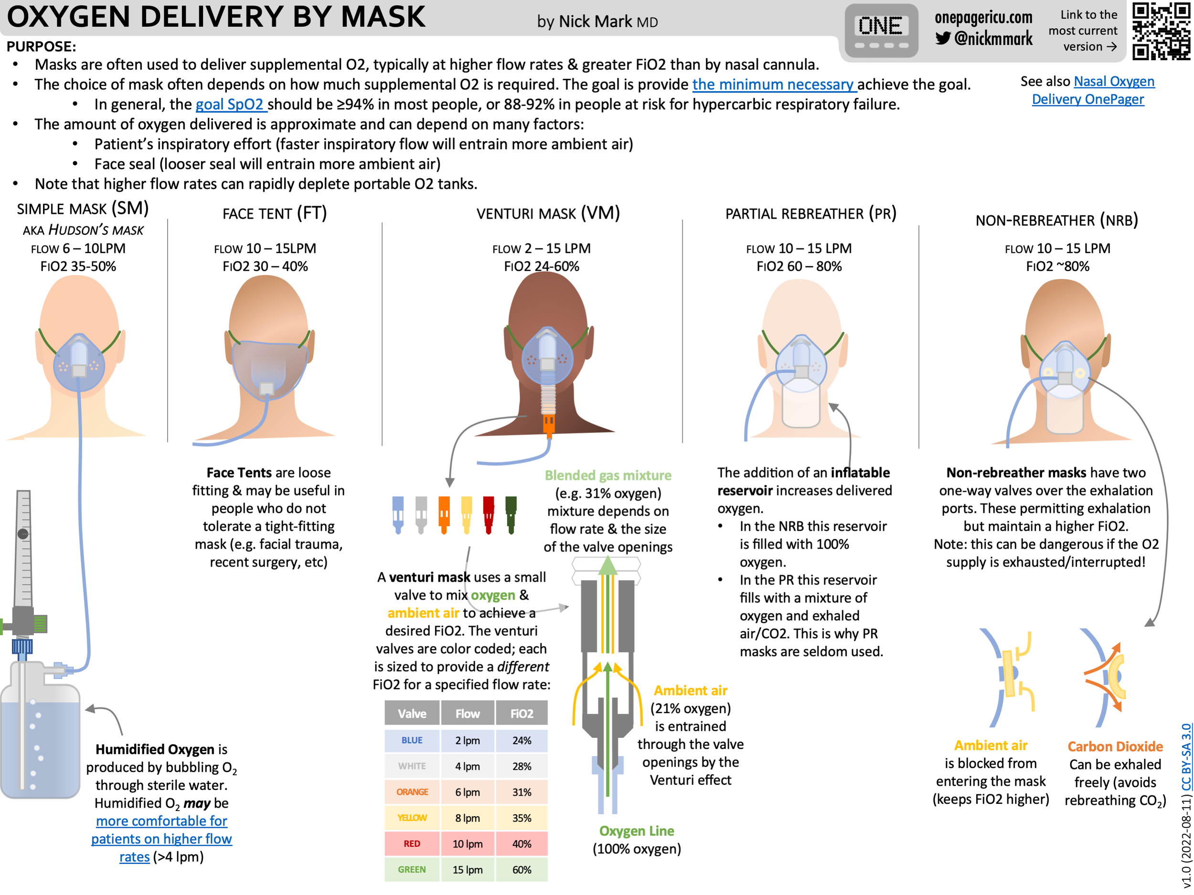

Slide 32
Planning Management
2 marks
Case presentation
A 50-year-old woman is reviewed on the surgical ward round after having a laparoscopic cholecystectomy. She is complaining of some palpitations.
Investigations
Hb 120, Na 140 (137-144), K 6.9 (3.5-5.3), U 4.8 (2.5-7.0), Cr 65 (60-110), eGFR >90 (>60). ECG shows mildly peaked T waves.
MANAGEMENT OPTIONS
sodium chloride 0.9%, 1000ml over 4h IV | 10mg | PO | daily
calcium gluconate 10%, 30ml over 10m IV | 70mg | PO | daily
salbutamol 500 mcg nebulised | 40mg | PO | daily
glucose 20%, 20mls over 15m IV | 5mg | PO | daily
calcium polystyrene sulfonate 15g PO | 2 tablets | PO | twice daily
Question
Select the most appropriate management option at this stage.
MAN Q4

Slide 33
Planning Management
2 marks
Case presentation
A 50-year-old woman is reviewed on the surgical ward round after having a laparoscopic cholecystectomy. She is complaining of some palpitations.
Investigations
Hb 120, Na 140 (137-144), K 6.9 (3.5-5.3), U 4.8 (2.5-7.0), Cr 65 (60-110), eGFR >90 (>60). ECG shows mildly peaked T waves.
MANAGEMENT OPTIONS
sodium chloride 0.9%, 1000ml over 4h IV | 10mg | PO | daily
calcium gluconate 10%, 30ml over 10m IV | 70mg | PO | daily |  | ✓
salbutamol 500 mcg nebulised | 40mg | PO | daily
glucose 20%, 20mls over 15m IV | 5mg | PO | daily
calcium polystyrene sulfonate 15g PO | 2 tablets | PO | twice daily
Question
Select the most appropriate management option at this stage.
This is an example of emergency hyperkalaemia with ECG changes. You need to give calcium gluconate urgently.
Sodium chloride 0.9% would not help her hyperkalaemia.
The remaining options are all treatments for hyperkalaemia but not in the emergency setting with ECG changes.
MAN A4

Slide 34
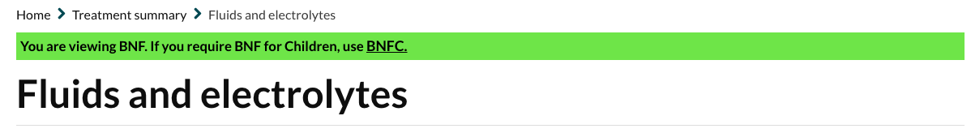
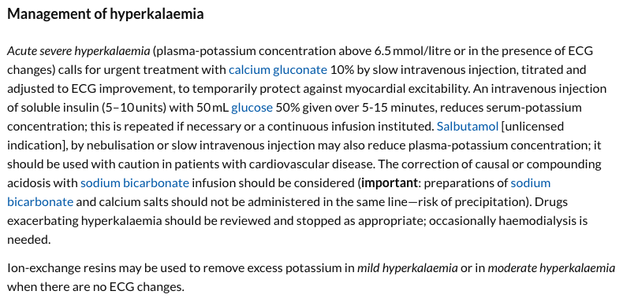

Slide 35
 | Causes | Symptoms | Diagnosis | Treatment
Hypokalaemia | Intake – low K+ diet Drugs – loop or thiazide diuretics, steroids Transcellular shift – alkalosis, refeeding syndrome, SABA, insulin, hypomagnesemia Endocrine – Cushing’s syndrome, DI, primary polydipsia, hyperaldosteronism (Conn’s syndrome) Renal – dialysis GI – vomiting, diarrhoea Pseudo – leukocytosis | Metabolic alkalosis Arrythmias Muscle weakness Reduced reflexes Constipation | K <3.5 ECG – ‘In hypokalaemia U have no Pot or no T but a long PR and a long QT’ | 0.3% potassium chloride, 1000ml over 4h Sando K
Hyperkalaemia | Intake – high K+ diet, K+ supplementation (fluids, sando K), blood transfusion Drugs – K+ sparing diuretics, ACEi, ARB, NSAIDs, BB Transcellular shift – acidosis Endocrine – hypoaldosteronism (Addison’s disease) Renal – AKI, CKD GI – nil Pseudo – haemolysed sample, dehydration | Metabolic acidosis Arrythmias Muscle weakness Reduced reflexes Diarrhoea | K >5.3 ECG – absent P waves, prolonged QRS, peaked or ‘tall tented’ T waves, sine wave pattern | calcium gluconate 10%, 30ml over 10m Short-term – insulin + glucose, salbutamol Long-term – calcium polystyrene sulfonate, loop diuretics, dialysis

Slide 36
Communicating Information
2 marks
Case presentation
A 72-year-old man is started on amitriptyline for ongoing neuropathic pain.
INFORMATION OPTIONS
it might cause weight changes | 10mg | PO | daily
the dose must be titrated up | 70mg | PO | daily
he must avoid bright sunlight | 40mg | PO | daily
avoid operating heavy machinery if drinking alcohol | 5mg | PO | daily
drowsiness is a common side effect | 2 tablets | PO | twice daily
Question
Select the most important information option that should be provided for the patient.
COM Q1

Slide 37
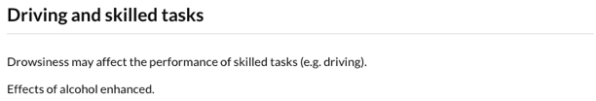
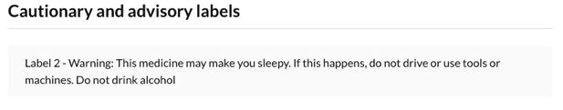
Communicating Information
2 marks
Case presentation
A 72-year-old man is started on amitriptyline for ongoing neuropathic pain.
INFORMATION OPTIONS
it might cause weight changes | 10mg | PO | daily
the dose must be titrated up | 70mg | PO | daily
he must avoid bright sunlight | 40mg | PO | daily
avoid operating heavy machinery if drinking alcohol | 5mg | PO | daily |  | ✓
drowsiness is a common side effect | 2 tablets | PO | twice daily
Question
Select the most important information option that should be provided for the patient.
Many of these options are correct but which is the most important?
Alcohol can enhance the effect of amitriptyline meaning operating heavy machinery would be very dangerous. This must be avoided.
COM A1

Slide 38
Communicating Information
2 marks
Case presentation
A 12-year-old girl is started on an insulin pump for newly diagnosed T1DM.
INFORMATION OPTIONS
she must monitor her blood glucose six times a day | 10mg | PO | daily
she should seek medical help if she is unable to drink fluids due to N&V | 70mg | PO | daily
she should check ketones if her blood glucose is >10mmol | 40mg | PO | daily
she will need to have blood tests to check HbA1c | 5mg | PO | daily
she must be aware of the signs of hypoglycaemia | 2 tablets | PO | twice daily
Question
Select the most important information option that should be provided for the patient.
COM Q2

Slide 39
Communicating Information
2 marks
Case presentation
A 12-year-old girl is started on an insulin pump for newly diagnosed T1DM.
INFORMATION OPTIONS
she must monitor her blood glucose six times a day | 10mg | PO | daily
she should seek medical help if she is unable to drink fluids due to N&V | 70mg | PO | daily |  | ✓
she should check ketones if her blood glucose is >10mmol | 40mg | PO | daily
she will need to have blood tests to check HbA1c | 5mg | PO | daily
she must be aware of the signs of hypoglycaemia | 2 tablets | PO | twice daily
Question
Select the most important information option that should be provided for the patient.
These are all examples of sick day rules discussed during session 4
Some are incorrect…
Monitoring BMS six times a day is too frequent
Ketones should be checked if BMs >15
The other two options are true but less important
Patients with T1DM must seek medical help if they are unable to drink fluids due to N&V as they are at a very high risk of developing a DKA and need urgent IVI
COM A2

Slide 40
Communicating Information
2 marks
Case presentation
A 78-year-old women develops C. difficile after taking clindamycin for a diabetic foot infection.
INFORMATION OPTIONS
oral vancomycin is taken four times a day | 10mg | PO | daily
IV vancomycin is as effective as oral vancomycin | 70mg | PO | daily
vancomycin will clear any MRSA skin colonisation | 40mg | PO | daily
she will require regular blood tests to check LFTs | 5mg | PO | daily
if vancomycin dose not clear the infection, she will require anti-TNF therapies | 2 tablets | PO | twice daily
Question
Select the most important information option that should be provided for the patient.
COM Q3

Slide 41
Communicating Information
2 marks
Case presentation
A 78-year-old women develops C. difficile after taking clindamycin for a diabetic foot infection.
INFORMATION OPTIONS
oral vancomycin is taken four times a day | 10mg | PO | daily |  | ✓
IV vancomycin is as effective as oral vancomycin | 70mg | PO | daily
vancomycin will clear any MRSA skin colonisation | 40mg | PO | daily
she will require regular blood tests to check LFTs | 5mg | PO | daily
if vancomycin dose not clear the infection, she will require anti-TNF therapies | 2 tablets | PO | twice daily
Question
Select the most important information option that should be provided for the patient.
This is the only true option
IV vancomycin will not be effective for C. difficile as it will not reach the bowel
Vancomycin will not clear any skin MRSA colonization although can be used for MRSA associated infections
LFT monitoring is not indicated, monitoring of serum-vancomycin concentration is recommended In inflammatory bowel disorders
Immunosuppressive therapies only indicated in life threatening C. difficile infections. ‘She will need’ is a strong statement and not a definite.
COM A3

Slide 42
Calculation Skills
2 marks
Case presentation
An 80-year-old man with terminal prostate cancer has been taking Zomorph (morphine sulphate MR) 80mg twice daily supplemented with oromorph (morphine sulphate oral solution) PO PRN. Over the last 24h he has required:
08:00 30mg oromorph
18:00 10mg oromorph
He would like this to be switched to a syringe driver which is delivered subcutaneously. 10mg morphine sulphate orally is equivalent to 5mg morphine subcutaneously. The concentration of morphine to be administered subcutaneously is 10mg/10ml.
Answer ml/h
Prescribing request
At what rate (ml/h) should the morphine sulphate subcutaneous syringe driver be set?
(write your answer in the box provided to 2 decimal places)
CAL Q1

Slide 43
Calculation Skills
2 marks
Case presentation
An 80-year-old man with terminal prostate cancer has been taking Zomorph (morphine sulphate MR) 80mg twice daily supplemented with oromorph (morphine sulphate oral solution) PO PRN. Over the last 24h he has required:
08:00 30mg oromorph
18:00 10mg oromorph
He would like this to be switched to a syringe driver which is delivered subcutaneously. 10mg morphine sulphate orally is equivalent to 5mg morphine subcutaneously. The concentration of morphine to be administered subcutaneously is 10mg/10ml.
Answer ml/h
Zomorph = 80mg x 2 = 160mg
Oromorph = 30mg + 10mg = 40mg
160mg + 40mg = 200mg per day of morphine sulphate PO
200mg/2 = 100mg per day of morphine sulphate SC
10mg/10ml
100mg/100ml
100ml/24h = 4.17ml/h
4.17
Prescribing request
At what rate (ml/h) should the morphine sulphate subcutaneous syringe driver be set?
(write your answer in the box provided to 2 decimal places)
CAL A1

Slide 44
Calculation Skills
2 marks
Case presentation
A 6-month-old girl requires aciclovir 500mg/m² 8-hourly IV for 10 days. Body surface area = 0.4 m².
Aciclovir is available in 250mg vials and must be used immediately after reconstitution with sodium chloride 0.9% 50mls. Any left over drug must be disposed of and new vials used for each dose.
Answer vials
Prescribing request
How many vials of aciclovir will the patient need to complete the 10-day course?
(write your answer in the box provided)
CAL Q2

Slide 45
Calculation Skills
2 marks
Case presentation
A 6-month-old girl requires aciclovir 500mg/m² 8-hourly IV for 10 days. Body surface area = 0.4 m².
Aciclovir is available in 250mg vials and must be used immediately after reconstitution with sodium chloride 0.9% 50mls. Any left over drug must be disposed of and new vials used for each dose.
Answer vials
500mg x 0.4m² = 200mg dose
Vials contain 250mg so one vial per dose
1 x 3 (needs to be given 8-hourly ie. TDS) = 3 bottles per day
3 x 10 = 30 bottles for 10-day course
30
Prescribing request
How many vials of aciclovir will the patient need to complete the 10-day course?
(write your answer in the box provided)
CAL A2

Slide 46
Calculation Skills
2 marks
Case presentation
A 26-year-old man with a dog bite requires treatment with co-amoxiclav 1.2g by intravenous infusion. Weight 82kg. Prior to administration, co-amoxiclav powder needs to be diluted with sodium chloride 0.9% to a concentration of 10mg/ml. It is then administered over 30-40 minutes.
Answer ml
Prescribing request
What volume (ml) of the diluted co-amoxiclav should be given intravenously?
(write your answer in the box provided)
CAL Q3

Slide 47
Calculation Skills
2 marks
Case presentation
A 26-year-old man with a dog bite requires treatment with co-amoxiclav 1.2g by intravenous infusion. Weight 82kg. Prior to administration, co-amoxiclav powder needs to be diluted with sodium chloride 0.9% to a concentration of 10mg/1ml. It is then administered over 30-40 minutes.
Answer ml
1.2g dose
1.2g x 1000 = 1200mg (don’t forget to change units early)
10mg/1ml concentration
1200mg/120ml (1ml/10mg x 120mg = 12ml)
volume = dose/concentration
volume = 1200mg/10mg/1ml
volume = 120ml
120
Prescribing request
What volume (ml) of the diluted co-amoxiclav should be given intravenously?
(write your answer in the box provided)
CAL A3

Slide 48
Calculation Skills
2 marks
Case presentation
A 71-year-old man has been started on a chlordiazepoxide reducing dose regime for alcohol withdrawal with moderate dependence.
Planned reducing dose:
2 days 30mg PO four times daily
2 days 20mg PO four times daily
2 days 10mg PO four times daily
2 days 5mg PO four times daily
Chlordiazepoxide is available as 5mg tablets in blister packs containing 12 tablets.
Answer blister packs
Prescribing request
How many blister packs of chlordiazepoxide will the patient need to complete the reducing dose regime?
(write your answer in the box provided)
CAL Q4

Slide 49
Calculation Skills
2 marks
Case presentation
A 71-year-old man has been started on a chlordiazepoxide reducing dose regime for alcohol withdrawal with moderate dependence.
Planned reducing dose:
2 days 30mg PO four times daily
2 days 20mg PO four times daily
2 days 10mg PO four times daily
2 days 5mg PO four times daily
Chlordiazepoxide is available as 5mg tablets in blister packs containing 12 tablets.
Answer blister packs
2 x 30mg x 4 = 240mg
2 x 20mg x4 = 160mg
2 x 10mg x4 = 80mg
2 x 5mg x4 = 40mg
240mg + 160mg + 80mg + 40mg = 520mg
5mg tablets available
520mg/5 = 104 tablets
104 tablets/12 = 8.67 packs required
ie. 9 packs (you have to round up)
9
Prescribing request
How many blister packs of chlordiazepoxide will the patient need to complete the reducing dose regime?
(write your answer in the box provided)
CAL A4

Slide 50
Adverse Drug Reaction
2 marks
Case presentation
A 67-year-old woman is noted to have QT prolongation on her admission ECG. QTc 540ms. PMH. Depression. DH. Citalopram.
ADVERSE EFFECT OPTIONS
amiloride | 10mg | PO | daily
amitriptyline | 70mg | PO | daily
ibuprofen | 40mg | PO | daily
ondansetron | 5mg | PO | daily
salbutamol | 2 tablets | PO | twice daily
Question
Which medication is most likely to interact with citalopram to cause QT prolongation?
ADR Q1

Slide 51
Adverse Drug Reaction
2 marks
Case presentation
A 67-year-old woman is noted to have QT prolongation on her admission ECG. QTc 540ms. PMH. Depression. DH. Citalopram.
ADVERSE EFFECT OPTIONS
amiloride | 10mg | PO | daily
amitriptyline | 70mg | PO | daily
ibuprofen | 40mg | PO | daily
ondansetron | 5mg | PO | daily |  | ✓
salbutamol | 2 tablets | PO | twice daily
Question
Which medication is most likely to interact with citalopram to cause QT prolongation?
This is a simple question, check each drug in the interactions section for citalopram (remembering to use CTRL + F) and only ondansetron will increase risk of QT prolongation when used in conjunction.
ADR A1

Slide 52
Adverse Drug Reaction
2 marks
Case presentation
A 53-year-old man presents after taking an overdose of paracetamol. He says he has taken a pack of 20 paracetamol tablets, 500mg each. Weight 54kg.
ADVERSE EFFECT OPTIONS
540mg | 70mg | PO | daily
5400mg | 40mg | PO | daily
8100mg | 40mg | PO | daily
1080mg | 5mg | PO | daily
10800mg | 2 tablets | PO | twice daily
Question
What dose of acetylcysteine is required to prepare the first infusion of the 12-hour SNAP regimen?
ADR Q2

Slide 53

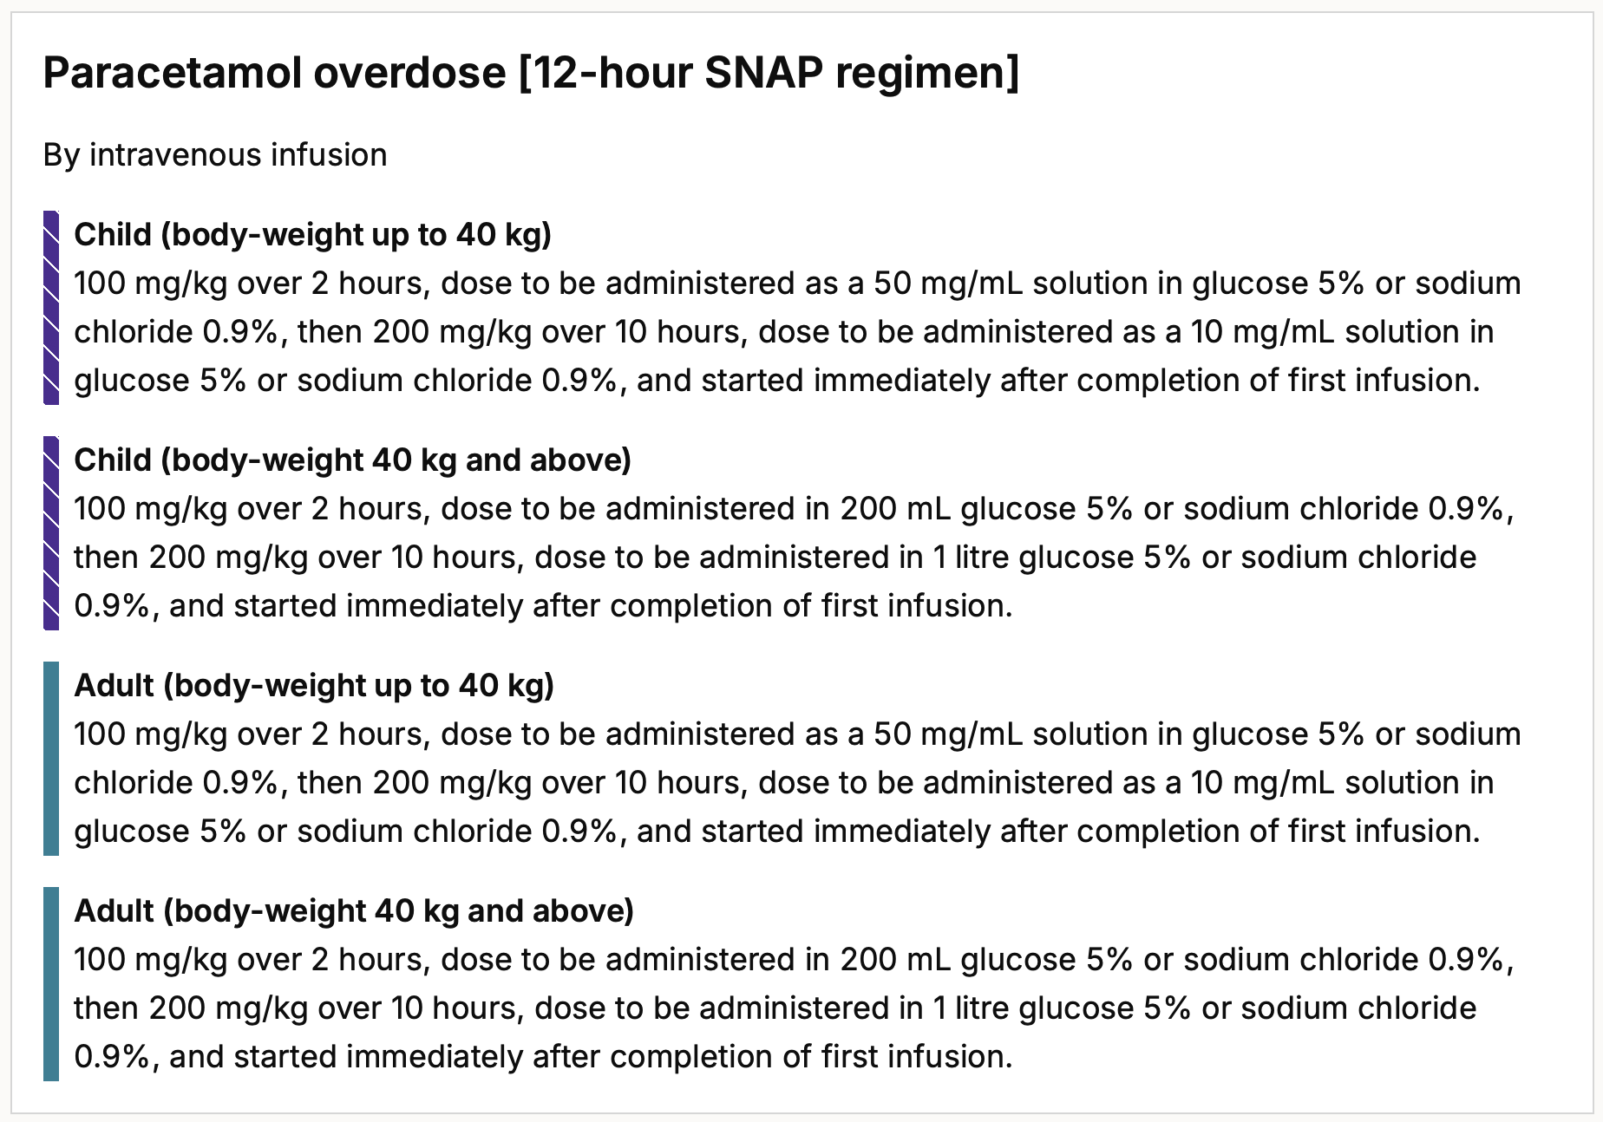
Adverse Drug Reaction
2 marks
Case presentation
A 53-year-old man presents after taking an overdose of paracetamol. He says he has taken a pack of 20 paracetamol tablets, 500mg each. Weight 54kg.
ADVERSE EFFECT OPTIONS
540mg | 70mg | PO | daily
5400mg | 40mg | PO | daily |  | ✓
8100mg | 40mg | PO | daily
1080mg | 5mg | PO | daily
10800mg | 2 tablets | PO | twice daily
Question
What dose of acetylcysteine is required to prepare the first infusion of the 12-hour SNAP regimen?
Use the treatment summary above for overdose questions.
Remember there are the 12-hour SNAP regimen and the 21-hour regimen which have different doses.
ADR A2

Slide 54
Paracetamol overdose
Remember:
Paracetamol is broken down into two non-toxic molecules and one toxic molecule called NAPQI
NAPQI is usually broken down to a non-toxic form by glutathione in the liver
In paracetamol overdose there is not enough glutathione as it is all used up
This means NAPQI cannot all be broken down resulting acute liver failure and liver necrosis
NAC is a precursor of glutathione, so it resupplies the glutathione stores allowing NAPQI to be broken down again
King’s College Hospital criteria used to determine if liver transplant required:
Arterial pH <7.3 after 24 hours of treatment
OR ALL OF – INR >6.5, creatinine AND grade 3/4 encephalopathy

Slide 55
Adverse Drug Reaction
2 marks
Case presentation
A 42-year-old woman attends her GP for help with smoking cessation. It has been agreed to trial varenicline with an uptitrating dose for 12 weeks.
ADVERSE EFFECT OPTIONS
hyperglycaemia | 10mg | PO | daily
loss of consciousness | 70mg | PO | daily
menorrhagia | 40mg | PO | daily
suicidal ideation | 5mg | PO | daily
abnormal dreams | 2 tablets | PO | twice daily
Question
Select the adverse effect which is most likely to be caused by this medication.
ADR Q3

Slide 56
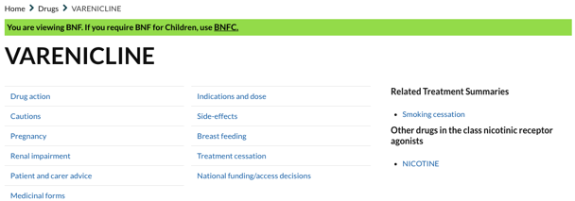
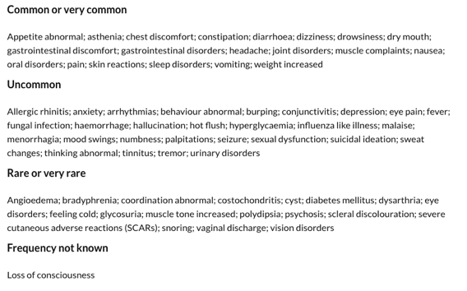
Adverse Drug Reaction
2 marks
Case presentation
A 42-year-old woman attends her GP for help with smoking cessation. It has been agreed to trial varenicline with an uptitrating dose for 12 weeks.
ADVERSE EFFECT OPTIONS
hyperglycaemia | 10mg | PO | daily
loss of consciousness | 70mg | PO | daily
menorrhagia | 40mg | PO | daily
suicidal ideation | 5mg | PO | daily
abnormal dreams | 2 tablets | PO | twice daily |  | ✓
Question
Select the adverse effect which is most likely to be caused by this medication.
Abnormal dreams are a classic side effect to warn patients of starting on varenicline. It is listed as sleep disorders on the BNF.
The other adverse effects are all true but less common.
ADR A3

Slide 57
Adverse Drug Reaction
2 marks
Case presentation
A 35-year-old man presents after taking an overdose of amitriptyline. It is unclear how much he has taken. He is tachycardic and drowsy.
ADVERSE EFFECT OPTIONS
atropine 3mg IV | 10mg | PO | daily
calcium gluconate 10%, 10ml over 10m IV | 70mg | PO | daily
haemodialysis | 40mg | PO | daily
hydrocortisone 10mg IV | 5mg | PO | daily
sodium bicarbonate 50mmol IV | 2 tablets | PO | twice daily
Question
Select the most appropriate option for the immediate management of this adverse drug reaction.
ADR Q4

Slide 58
Adverse Drug Reaction
2 marks
Case presentation
A 35-year-old man presents after taking an overdose of amitriptyline. It is unclear how much he has taken. He is tachycardic and drowsy. QRS duration 130ms.
ADVERSE EFFECT OPTIONS
atropine 3mg IV | 10mg | PO | daily
calcium gluconate 10%, 10ml over 10m IV | 70mg | PO | daily
haemodialysis | 40mg | PO | daily
hydrocortisone 10mg IV | 5mg | PO | daily
sodium bicarbonate 50mmol IV | 2 tablets | PO | twice daily |  | ✓
Question
Select the most appropriate option for the immediate management of this adverse drug reaction.
TCA overdoses cause sodium channel blocking in the myocardium which can result in arrythmias. The first sign is QRS prolongation. Sodium bicarbonate increases TCA protein binding, dislodging TCAs from the sodium channel and increasing TCA elimination.
Atropine → bradyarthymias
Calcium gluconate → emergency hypocalcaemia, emergency hyperkalaemia
Haemodialysis → overdoses with organ failure, not first line
Hydrocortisone → Addisonian crisis
ADR A4

Slide 59
Drug Monitoring
2 marks
Case presentation
A 69-year-old woman is started on apixaban for atrial fibrillation.
MONITORING OPTIONS
INR | 10mg | PO | daily
aPTT | 70mg | PO | daily
PT | 40mg | PO | daily
anti-factor Xa | 5mg | PO | daily
monitor clinically | 2 tablets | PO | twice daily
Question
Select the most appropriate monitoring option that should be arranged for this patient.
TDM Q1

Slide 60
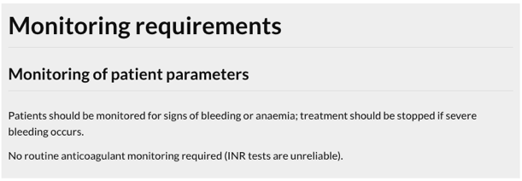
Drug Monitoring
2 marks
Case presentation
A 69-year-old woman is started on apixaban for atrial fibrillation.
MONITORING OPTIONS
INR | 10mg | PO | daily
aPTT | 70mg | PO | daily
PT | 40mg | PO | daily
anti-factor Xa | 5mg | PO | daily
monitor clinically | 2 tablets | PO | twice daily |  | ✓
Question
Select the most appropriate monitoring option that should be arranged for this patient.
This is why NOACs are being used so much now, ‘one dose fits all’ and no routine monitoring required!
Warfarin → INR
Unfractioned heparin → aPTT (and platelets watch out for HIT)
LMWH → anti-factor Xa
TDM A1

Slide 61
Drug Monitoring
2 marks
Case presentation
A 45-year-old man has his oral theophylline dose increased for worsening asthma.
MONITORING OPTIONS
plasma-theophylline concentration in 4-6 hours | 10mg | PO | daily
plasma-theophylline concentration in 8-12 hours | 70mg | PO | daily
plasma-theophyilline concentration in 1 days time | 70mg | PO | daily
plasma-theophyilline concentration in 2 days time | 40mg | PO | daily
plasma-theophyilline concentration in 3 days time | 5mg | PO | daily
Question
Select the most appropriate monitoring option that should be arranged for this patient.
TDM Q2

Slide 62
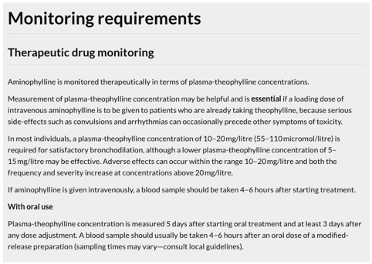
Drug Monitoring
2 marks
Case presentation
A 45-year-old man has his oral theophylline dose increased for worsening asthma.
MONITORING OPTIONS
plasma-theophylline concentration in 4-6 hours | 10mg | PO | daily
plasma-theophylline concentration in 8-12 hours | 70mg | PO | daily
plasma-theophyilline concentration in 1 days time | 70mg | PO | daily
plasma-theophyilline concentration in 2 days time | 40mg | PO | daily
plasma-theophyilline concentration in 3 days time | 5mg | PO | daily |  | ✓
Question
Select the most appropriate monitoring option that should be arranged for this patient.
Check the ‘monitoring requirements’ page for aminophylline, it recommends a plasma-theophylline concentration check at least 3 days after any dose adjustment (with oral use)
A2

Slide 63
Drug Monitoring
2 marks
Case presentation
A 23-year-old woman attends for her diabetes nurse review. She has been asymptomatic and recording her capillary glucose levels in a diary. PMH. T1DM. DH. Insulin aspart 8 units with meals, insulin glargine (Lantus®) 12 units at night.
Her insulin glargine dose has been increased to 14 units.
MONITORING OPTIONS
HbA1c | 10mg | PO | daily
fructosamine | 70mg | PO | daily
pre-evening meal capillary glucose | 40mg | PO | daily
pre-bedtime capillary glucose | 5mg | PO | daily
pre-breakfast capillary glucose | 2 tablets | PO | twice daily
Question
Select the most appropriate monitoring option that should be arranged for this patient.
TDM Q3

Slide 64
Drug Monitoring
2 marks
Case presentation
A 23-year-old woman attends for her diabetes nurse review. She has been asymptomatic and recording her capillary glucose levels in a diary. PMH. T1DM. DH. Insulin aspart 8 units with meals, insulin glargine (Lantus®) 12 units at night.
Her insulin glargine dose has been increased to 14 units.
MONITORING OPTIONS
HbA1c | 10mg | PO | daily
fructosamine | 70mg | PO | daily
pre-evening meal capillary glucose | 40mg | PO | daily
pre-bedtime capillary glucose | 5mg | PO | daily
pre-breakfast capillary glucose | 2 tablets | PO | twice daily |  | ✓
Question
Select the most appropriate monitoring option that should be arranged for this patient.
You need to monitor the pre-breakfast capillary glucose as this is the long acting insulin that will work to keep her blood glucose levels low overnight and into the next day.
They might also present you with capillary glucose levels at different time points and ask you to adjust the doses. Be comfortable with how to do this.
HbA1c → 3 month diabetic control picture
Fructosamine → 2 week diabetic control picture (good in pregnancy, blood disorders increasing RBC turnover etc.)
TDM A3

Slide 65
Drug Monitoring
2 marks
Case presentation
A 29-year-old woman is due to be started on lithium for long-term bipolar disorder. PMH. Bipolar disorder. DH. Aripiprazole. The psychiatrist informs her that some monitoring tests need to be carried out before lithium can be started.
MONITORING OPTIONS
FBC, U&Es, ECG | 10mg | PO | daily
FBC, U&Es, TFTs | 5mg | PO | daily
FBC, U&Es, TFTs, BMI | 5mg | PO | daily
FBC, U&Es, LFTs, BMI, ECG | 2 tablets | PO | twice daily
FBC, U&Es, TFTs, BMI, ECG | 2 tablets | PO | twice daily
Question
Select the most appropriate monitoring option that should be arranged for this patient.
TDM Q4

Slide 66
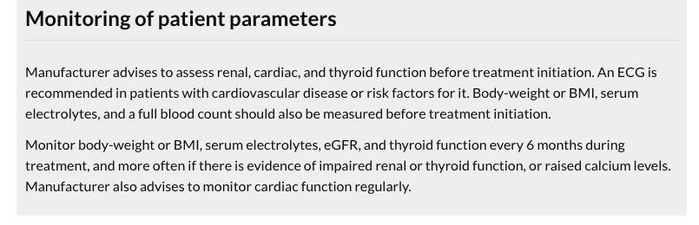
Drug Monitoring
2 marks
Case presentation
A 29-year-old woman is due to be started on lithium for long-term bipolar disorder. PMH. Bipolar disorder. DH. Aripiprazole. The psychiatrist informs her that some monitoring tests need to be carried out before lithium can be started.
MONITORING OPTIONS
FBC, U&Es, ECG | 10mg | PO | daily
FBC, U&Es, TFTs | 5mg | PO | daily
FBC, U&Es, TFTs, BMI | 5mg | PO | daily |  | ✓
FBC, U&Es, LFTs, BMI, ECG | 2 tablets | PO | twice daily
FBC, U&Es, TFTs, BMI, ECG | 2 tablets | PO | twice daily
Question
Select the most appropriate monitoring option that should be arranged for this patient.
Lithium is a common PSA question. There is lots they can ask.
As per the BNF the required things to assess before starting lithium are FBC, U&Es, TFTs and BMI (also ECG if cardiovascular disease or risk factors for it but not needed for this scenario).
Key things to remember regarding lithium:
Monitor FBC, U&Es, TFTs, BMI ± ECG every 6 months
Serum-lithium should be checked 12 hours after the dose and be 0.4-1mmol/L
Routine serum-lithium monitoring should be performed weekly after initiation and after each dose change until concentrations are stable, then every 3 months for the first year and every 6 months thereafter
Sx of lithium toxicity are muscle weakness → dizziness → ataxia → course tremor → seizures → disorientation → coma → death
TDM A4

Slide 67
Data Interpretation
2 marks
Case presentation
A 73-year-old who is being treated for an exacerbation of COPD is noted to have a raised INR of 6.3. He is otherwise well with no signs of bleeding. PMH. Atrial fibrillation, COPD. DH. Warfarin (6.5mg PO daily on Monday, Wednesday, Friday; 5mg PO daily on Tuesday, Thursday, Saturday, Sunday) Salbutamol 100mcg 2 puffs PRN, tiotropium 18mcg 1 puff once daily.
no change necessary | 10mg | PO | daily
reduce subsequent maintenance dose | 10mg | PO | daily
withhold 1 or 2 doses of warfarin and reduce subsequent maintenance dose | 70mg | PO | daily
stop warfarin; give vitamin K by slow intravenous injection; restart warfarin when INR <5.0 | 5mg | PO | daily
stop warfarin; give vitamin K by mouth using the intravenous preparation orally; repeat dose of vitamin K if INR still too high after 24 hours; restart warfarin when INR <5.0 | 2 tablets | PO | twice daily
DECISION OPTIONS
Question
Select the most appropriate decision option with regard to the clinical presentation and data.
DAT Q1

Slide 68
Data Interpretation
2 marks
Case presentation
A 73-year-old who is being treated for an exacerbation of COPD is noted to have a raised INR of 6.3. He is otherwise well with no signs of bleeding. PMH. Atrial fibrillation, COPD. DH. Warfarin (6.5mg PO daily on Monday, Wednesday, Friday; 5mg PO daily on Tuesday, Thursday, Saturday, Sunday) Salbutamol 100mcg 2 puffs PRN, tiotropium 18mcg 1 puff once daily.
no change necessary | 10mg | PO | daily
reduce subsequent maintenance dose | 10mg | PO | daily
withhold 1 or 2 doses of warfarin and reduce subsequent maintenance dose | 70mg | PO | daily |  | ✓
stop warfarin; give vitamin K by slow intravenous injection; restart warfarin when INR <5.0 | 5mg | PO | daily
stop warfarin; give vitamin K by mouth using the intravenous preparation orally; repeat dose of vitamin K if INR still too high after 24 hours; restart warfarin when INR <5.0 | 2 tablets | PO | twice daily
DECISION OPTIONS
Question
Select the most appropriate decision option with regard to the clinical presentation and data.
This is another very typical PSA question. But don’t worry you don’t have to remember all of this – see the next slide!
DAT A1

Slide 69

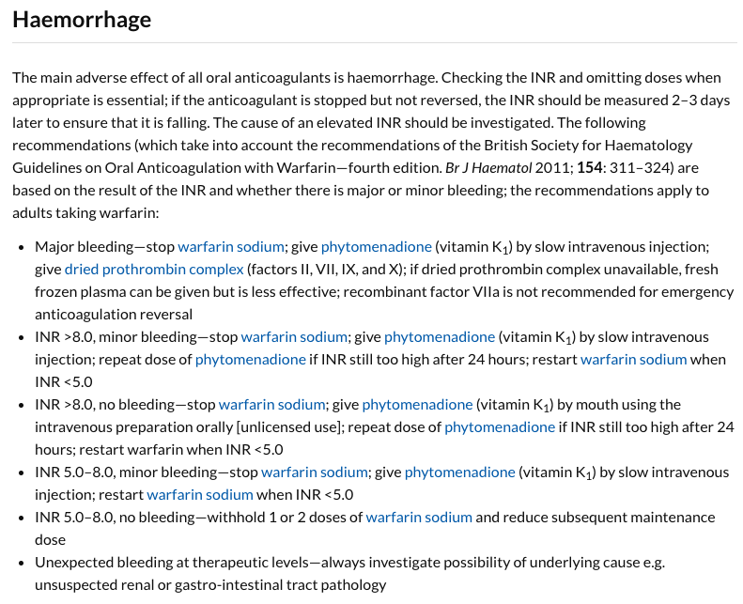
DAT A1

Slide 70
Data Interpretation
2 marks
Case presentation
A 35-year-old woman started taking levothyroxine 125mcg PO daily for hypothyroidism. She is due for a review at her GP who has requested she has a blood test.
Investigations
TSH 16.1 (0.5-5.5), free T4 6.5 (9-18), free T3 2.9 (3-7)
no change required | 10mg | PO | daily
decrease levothyroxine dose to 112.5mcg PO daily | 70mg | PO | daily
decrease levothyroxine dose to 100mcg PO daily | 40mg | PO | daily
increase levothyroxine dose to 137.5mcg PO daily | 40mg | PO | daily
increase levothyroxine dose to 150mcg PO daily | 5mg | PO | daily
DECISION OPTIONS
Question
Select the most appropriate decision option with regard to the clinical presentation and data.
DAT Q2

Slide 71
Data Interpretation
2 marks
Case presentation
A 35-year-old woman started taking levothyroxine 125mcg PO daily for hypothyroidism. She is due for a review at her GP who has requested she has a blood test.
Investigations
TSH 16.1 (0.5-5.5), free T4 6.5 (9-18), free T3 2.9 (3-7)
no change required | 10mg | PO | daily
decrease levothyroxine dose to 112.5mcg PO daily | 70mg | PO | daily
decrease levothyroxine dose to 100mcg PO daily | 40mg | PO | daily
increase levothyroxine dose to 137.5mcg PO daily | 40mg | PO | daily
increase levothyroxine dose to 150mcg PO daily | 5mg | PO | daily |  | ✓
DECISION OPTIONS
Question
Select the most appropriate decision option with regard to the clinical presentation and data.
Here you can see the raised TSH and low free T4 mean that her hypothyroidism control is not fully optimised. The correct answer would be to increase the dose which is done in 25mcg increments.
Remember when initiating levothyroxine TSH should be monitored every 3 months until a stable level has been achieved.
The starting dose is usually 1.6mcg/kg rounded up to the nearest 25mcg.
DAT A2

Slide 72
Data Interpretation
2 marks
Case presentation
A 14-year-old girl is being treated with tobramycin 150mg IV 8-hourly for a pseudomonal chest infection. PMH. Cystic fibrosis, T3c diabetes. DH. Insulin aspart 4 units with meals, insulin determir (Levemir®) 6 units at night, pancreatin (Creon 10000®) 1-2 tablets PO with meals.
Investigations
Serum tobramycin level:
Pre-dose – 3mg/L (range <2mg/L)
Post-dose – 10mg/L (ranged 8-12mg/L)
MONITORING OPTIONS
change to tobramycin 150mg inhaled 8-hourly | 10mg | PO | daily
change to tobramycin 100mg IV 8-hourly | 70mg | PO | daily
change to tobramycin 150mg IV 12-hourly | 40mg | PO | daily
change to tobramycin 200mg IV 12-hourly | 5mg | PO | daily
no change required | 2 tablets | PO | twice daily
Question
Select the most appropriate decision option with regard to the clinical presentation and data.
DAT Q3

Slide 73
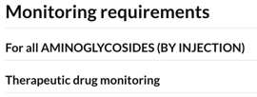
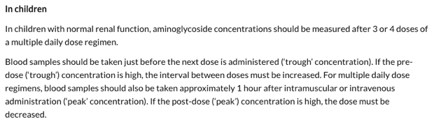
Data Interpretation
2 marks
Case presentation
A 14-year-old girl is being treated with tobramycin 150mg IV 8-hourly for a pseudomonal chest infection. PMH. Cystic fibrosis, T3c diabetes. DH. Insulin aspart 4 units with meals, insulin determir (Levemir®) 6 units at night, pancreatin (Creon 10000®) 1-2 tablets PO with meals.
Investigations
Serum tobramycin level:
Pre-dose – 3mg/L (range <2mg/L)
Post-dose – 10mg/L (ranged 8-12mg/L)
MONITORING OPTIONS
change to tobramycin 150mg inhaled 8-hourly | 10mg | PO | daily
change to tobramycin 100mg IV 8-hourly | 70mg | PO | daily
change to tobramycin 150mg IV 12-hourly | 40mg | PO | daily |  | ✓
change to tobramycin 200mg IV 12-hourly | 5mg | PO | daily
no change required | 2 tablets | PO | twice daily
For those of you that spotted T3c diabetes that isn’t a typo. I have only heard of it recently. Stands for type 3c diabetes, also known as pancreatogenic diabetes, and occurs secondary to conditions which affect the pancreas e.g. pancreatitis and cystic fibrosis.
The pre-dose level is too high suggesting the trough is too high. As per the BNF you need to increase the interval between doses.
Question
Select the most appropriate decision option with regard to the clinical presentation and data.
DAT A3

Slide 74
GOOD LUCK! We hope Prepare for the PSA has been helpful Clare and Phoebe

